Slide 1

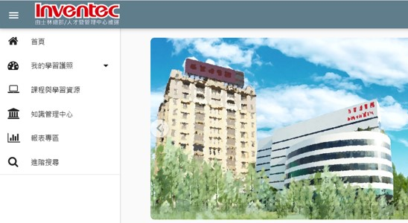
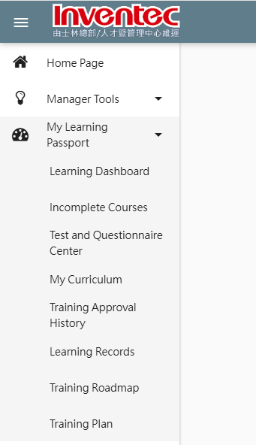
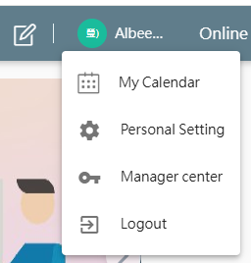
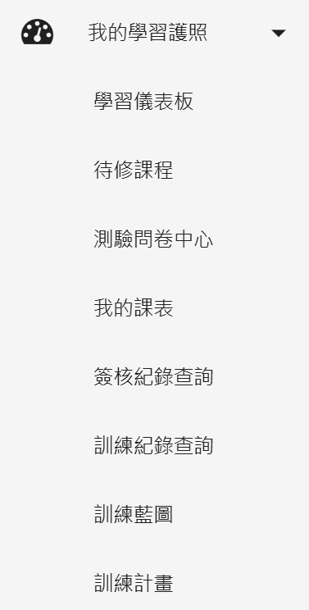
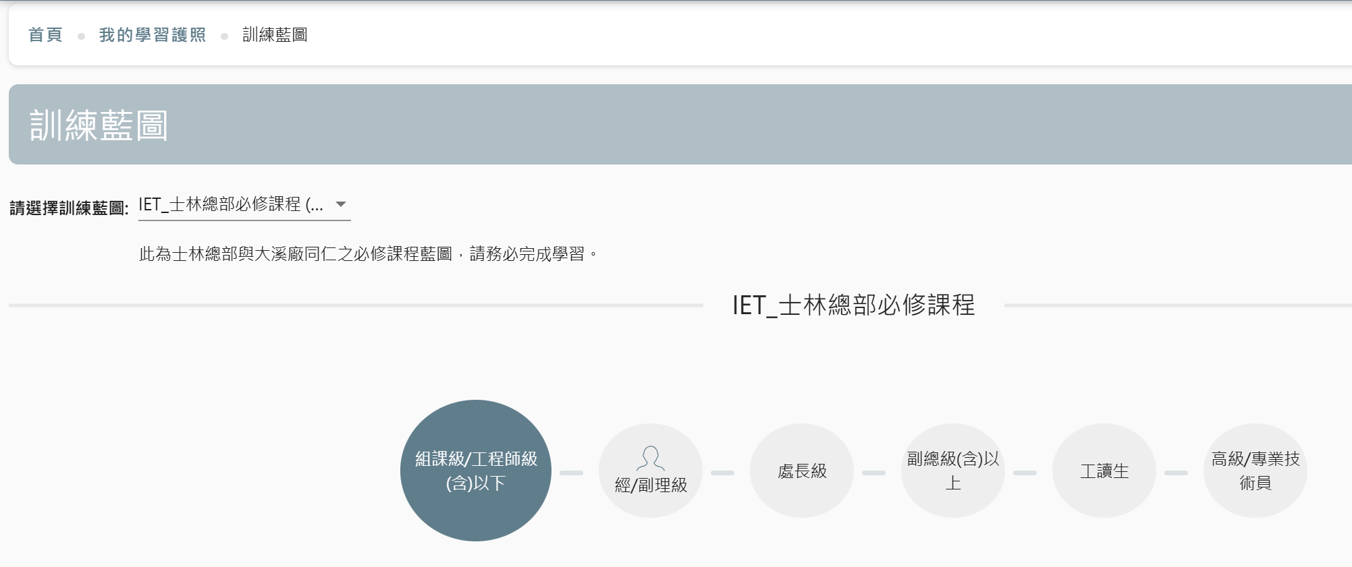
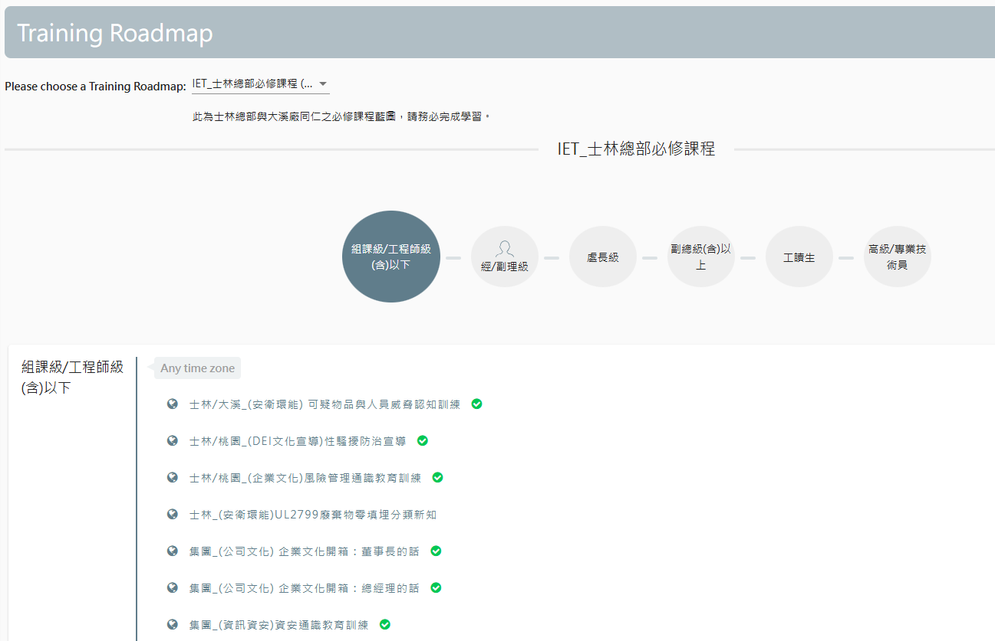
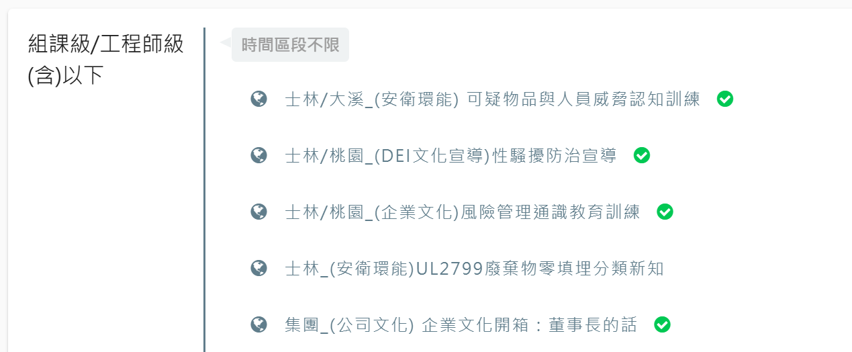


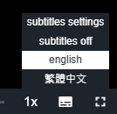

E-Learning數位學習平台藍圖
E-Learning介面說明&藍圖查詢步驟
E-Learning_My Learning Passport and Training Roadmap
E-Learning Interface Description and Steps
Step
1
選擇 我的學習護照
Choose
My Learning Passport
Choose Personal Setting
Change Language
若需更換語言可於此步驟設定
Choose
Training Roadmap
選擇 訓練藍圖
Step
2
選擇 藍圖種類
Choose
IET_士林總部必修課程
選擇 所屬職級
Choose
Your Job grade
Step
You can view the status of each required course.
就可以看到訓練藍圖的課程狀態囉
3
A green checkmark indicates
the completion of training.
綠勾為 完訓
無狀態則為 未完訓，點選課程即可上課
If there is no status, it means that the training has not been completed.
Please click on the course to begin your learning journey.
人才暨管理中心 / 人才發展部
Tips!!
English subtitles can be selected from the lower right corner of certain videos.
如需修改字幕語言，可於課程影片中「字幕」選項修改
Talent and Management Center / Talent Development Dept.
李梅君 Sherry #28450 張倪禎 Nica #21582
余佩倫 Yvonne #21823 陳吟綺 Villa #28418
金蓓瑩 Albee #21984

